Slide 1
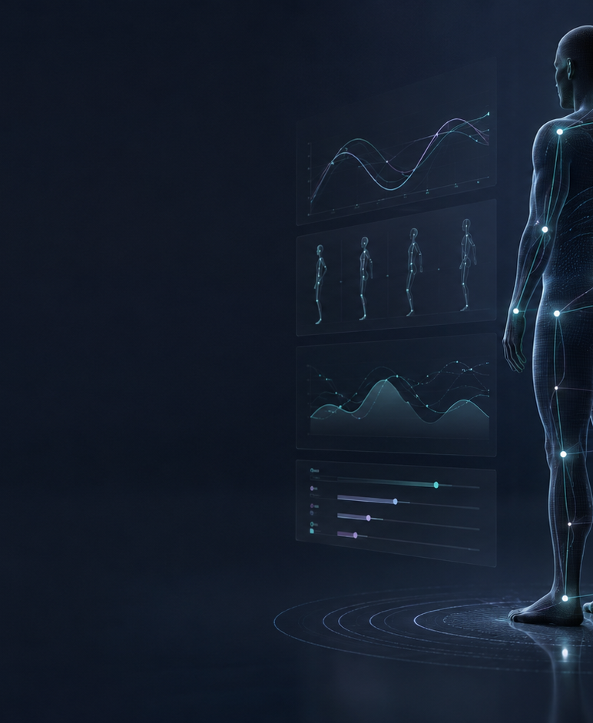
INVESTOR OVERVIEW | PRE-SEED | AUGUST 2026
Human function needs
a longitudinal record.
GHBI is building the intelligence layer that turns repeatable functional observations into structured change over time.
Global Human Biomechanics Intelligence Systems, Inc.
Patent pending | Working alpha/MVP | Pre-revenue
Notes:
[Sources]
- Company-provided materials and preliminary product data, August 2026
[/Sources]

Slide 2
THE PROBLEM
Healthcare records events. It rarely records function as a continuous story.
The missing layer is not another report; it is a structured timeline of how a person moves, feels and changes.
FRAGMENTED INPUTS
POINT-IN-TIME BIAS
PROVIDER BURDEN
Signals live apart
Snapshots hide change
Insight is hard to scale
Posture images, mobility measures, patient-reported outcomes, records and context are rarely organized together.
Single assessments can document a moment, but they do not consistently reveal progression, compensation or recovery.
Clinicians need repeatable capture and clear longitudinal comparison without losing professional judgment.
INVESTMENT THESIS
A trusted functional-data layer can become infrastructure across care, research and enterprise workflows.
GLOBAL HUMAN BIOMECHANICS INTELLIGENCE SYSTEMS, INC.
02
Notes:
[Sources]
- Company product thesis, August 2026
- Sequoia Capital, Writing a Business Plan: https://sequoiacap.com/article/writing-a-business-plan
[/Sources]

Slide 3
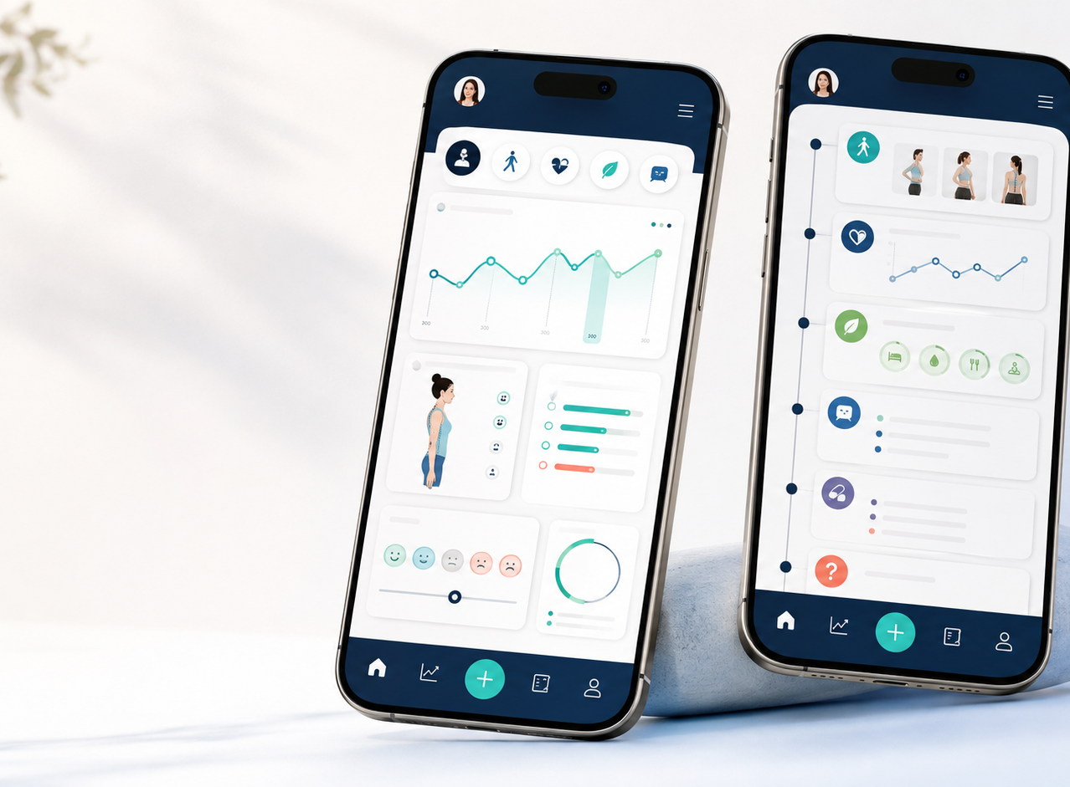
THE PLATFORM
GHBI connects provider workflow and individual context - with clear product boundaries.
The healthcare thesis centers on Global Platform and the upcoming My Functional Journey app.
GLOBAL PLATFORM
Provider web platform
Standardized capture, repeat assessment, structured reporting and longitudinal review. AI-assisted EMR interoperability is planned, not currently active.
MY FUNCTIONAL JOURNEY
Upcoming consumer companion
Educational and organizational support for functional information, goals and progress. Not diagnosis or treatment.
XOX26 is a separate creator/teleprompter product and is outside the healthcare investment thesis.
GLOBAL HUMAN BIOMECHANICS INTELLIGENCE SYSTEMS, INC.
03
Notes:
[Sources]
- Company product definitions, August 2026
- Concept image generated for GHBI brand materials, August 2026
[/Sources]

Slide 4
CURRENT PRODUCT
The alpha/MVP already supports a focused, testable workflow.
Scope is deliberately separated from future capabilities to avoid overstating maturity.
CURRENT ALPHA / MVP
Smartphone posture and range-of-motion workflow
PLANNED - REQUIRES VALIDATION
Provider workspace hardening
Secure file ingestion
Interoperability and EMR connectivity
Independent reliability and usability studies
Enterprise deployment controls
AI-assisted longitudinal decision support
Full-body 2D landmark tracking (60+ landmarks)
Angle extraction and basic metrics engine
25 integrated patient-reported surveys
Structured reports and repeat assessment
Secure cloud foundation and web administration
No current integration with Epic, Oracle Health/Cerner, athenahealth or any other named EMR vendor is claimed.
GLOBAL HUMAN BIOMECHANICS INTELLIGENCE SYSTEMS, INC.
04
Notes:
[Sources]
- Company MVP scope map and prior product materials, August 2026
[/Sources]

Slide 5
EARLY EVIDENCE
The working product has crossed from thesis into structured use.
These figures demonstrate product progress - not clinical validation, diagnostic performance or commercial traction.
60+
60+
25
2
preliminary structured captures
anatomical landmarks in workflow
integrated surveys
early clinical settings
1 longitudinal workflow
The system can organize repeated observations across time - the foundation for the longitudinal data thesis.
Evidence boundary: validation, outcome studies, paid pilots and recurring revenue remain milestones ahead.
GLOBAL HUMAN BIOMECHANICS INTELLIGENCE SYSTEMS, INC.
05
Notes:
[Sources]
- Company-provided preliminary product data, August 2026
[/Sources]

Slide 6
MARKET ENTRY
Start where the founder understands the workflow; expand where longitudinal function matters.
GHBI is using a focused provider wedge instead of claiming every market at once.
1
Design partners
2
Paid provider pilots
3
Enterprise expansion
3-5 musculoskeletal and rehabilitation-focused clinics to refine workflow, reliability and buyer value.
Convert validated workflows into time-bounded deployments with explicit success criteria.
Occupational health, research and health-system partnerships after evidence and controls mature.
Initial buyer
Expansion logic
Clinic owner, clinical director or innovation lead seeking repeatable functional documentation and progress review.
The same longitudinal layer can support larger deployments once validation, security and interoperability are proven.
GLOBAL HUMAN BIOMECHANICS INTELLIGENCE SYSTEMS, INC.
06
Notes:
[Sources]
- Company roadmap and customer-discovery plan, August 2026
[/Sources]

Slide 7
BUSINESS MODEL
A staged revenue model aligned to product maturity and buyer complexity.
Pricing remains a customer-discovery assumption until pilots validate willingness to pay.
FIRST
THEN
LATER
Clinic SaaS
Enterprise licensing
Consumer premium + API
Planned recurring subscriptions for provider access, workflows, reporting and longitudinal review.
Annual licenses plus implementation and integration services for larger organizations.
Optional My Functional Journey premium features and controlled research/API access after governance matures.
Revenue status
Pre-revenue | Founder-funded MVP | $0 institutional capital to date
A detailed pricing model and unit economics belong in diligence, not in unsupported public claims.
GLOBAL HUMAN BIOMECHANICS INTELLIGENCE SYSTEMS, INC.
07
Notes:
[Sources]
- Company fundraising materials, August 2026
[/Sources]

Slide 8
DEFENSIBILITY
The moat is the combination of IP, longitudinal structure and founder-developed workflow knowledge.
GHBI is not positioning a generic AI wrapper as defensibility.
IP
DATA ARCHITECTURE
KNOW-HOW
Patent-pending portfolio
Longitudinal structure
Clinical workflow fit
Multiple U.S. patent-pending applications cover core systems and methods. Foundational application 19/403,813 is referenced in company records.
Repeatable capture plus context creates a functional timeline that can become more valuable as validated deployments grow.
Direct experience with 1,500+ musculoskeletal patients informs what providers can realistically capture, review and use.
Diligence package
Patent schedules, chain-of-title/IP assignments, technical contracts and security documentation should be reviewed under NDA.
GLOBAL HUMAN BIOMECHANICS INTELLIGENCE SYSTEMS, INC.
08
Notes:
[Sources]
- Company-provided IP and founder background, August 2026. Patent status is not a legal opinion.
[/Sources]

Slide 9
COMPETITIVE POSITION
GHBI sits between systems of record and point-solution measurement tools.
The strategy is to connect repeatable functional signals over time, not replace every adjacent system.
ALTERNATIVE
WHAT IT DOES WELL
GHBI DIFFERENTIATION
EMR / system of record
Visits, orders, records
Longitudinal functional measurement
Posture or gait point tool
One modality or snapshot
Multimodal context across repeated assessments
Wearable / sensor platform
Continuous device signal
Provider-ready functional workflow and reporting
Motion laboratory
High-fidelity controlled analysis
Accessible smartphone-first workflow at broader scale
Investor diligence should still include named competitor benchmarking, pricing comparison and workflow interviews.
GLOBAL HUMAN BIOMECHANICS INTELLIGENCE SYSTEMS, INC.
09
Notes:
[Sources]
- Company positioning analysis, August 2026
- Sequoia Capital, How to Present to Investors: https://articles.sequoiacap.com/how-to-present-to-investors
[/Sources]

Slide 10
GO-TO-MARKET
Proof precedes scale.
The next 18-24 months are designed to convert product capability into validated buyer value and recurring revenue.
0-6 months
6-12 months
12-18 months
18-24 months
Design partners
Validated MVP
Paid pilots
Repeatable motion
Recruit 3-5 clinics; refine capture, usability and value hypothesis.
Independent reliability/usability work; security and provider workspace hardening.
Launch controlled paid deployments; establish conversion and retention signals.
First recurring revenue; enterprise pipeline and integration-ready foundation.
Gating principle
No enterprise-scale claims before reliability, security and workflow value are demonstrated.
GLOBAL HUMAN BIOMECHANICS INTELLIGENCE SYSTEMS, INC.
10
Notes:
[Sources]
- Company roadmap, August 2026
[/Sources]

Slide 11
TEAM
Founder-market fit is grounded in clinical practice and operating execution.
Technical development is supported by a long-standing contractor relationship with explicit public boundaries.
DR. RICARDO ALEJANDRO RODRÍGUEZ VÁZQUEZ, D.C.
Founder & CEO
RASIK RODRÍGUEZ
Technical Development Contractor
Palmer College of Chiropractic | MBA Accounting & Finance | M.Sc. Physiotherapy | M.Sc. Clinical Nutrition
Magi Enterprises LLC
15+ years software engineering experience
15+ year working relationship with the founder
1,500+
>$1M
4
musculoskeletal patients
C&WC sales in first 4 years
published books; 2 on neurobiomechanics
Scope, compensation, IP and security terms remain governed by company agreements.
GLOBAL HUMAN BIOMECHANICS INTELLIGENCE SYSTEMS, INC.
11
Notes:
[Sources]
- Company-provided founder and contractor biographies, August 2026
[/Sources]

Slide 12
THE ROUND
$1.0M pre-seed to turn a working alpha into a validated, pilot-ready company.
Capital is tied to milestone creation across an 18-24 month operating plan.
Product engineering and provider workspace
$1.0M
Security, privacy and interoperability readiness
Target raise
Independent validation and controlled pilots
Customer discovery, partnerships and go-to-market
Capital efficiency
Founder-funded MVP and $0 institutional capital to date.
IP, legal and operating infrastructure
Final budget, valuation, instrument and tranche structure are diligence items and should match the current financial model.
GLOBAL HUMAN BIOMECHANICS INTELLIGENCE SYSTEMS, INC.
12
Notes:
[Sources]
- Company fundraising materials, August 2026
[/Sources]

Slide 13
RISK DISCIPLINE
The company is early - the investment case depends on reducing four specific risks.
The pitch is credible only when the risks are named alongside the mitigation plan.
RISK
CURRENT REALITY
MITIGATION
Validation
Preliminary use is not clinical proof
Independent reliability, usability and outcomes work
Adoption
Provider value and pricing are not yet proven
Design partners, paid pilots and explicit success metrics
Regulatory
Future features may change product classification
Non-diagnostic scope, staged claims and regulatory counsel
Execution
Lean team and contractor dependencies
Milestone-based hiring, contracts, IP assignment and security controls
Next investor proof points
Named design partners | documented validation protocol | current financial model | complete data room
GLOBAL HUMAN BIOMECHANICS INTELLIGENCE SYSTEMS, INC.
13
Notes:
[Sources]
- Company risk assessment, August 2026
[/Sources]

Slide 14
THE ASK
Partner with GHBI to make
human function visible over time.
We are seeking aligned pre-seed investors, clinical design partners and strategic collaborators who understand healthcare infrastructure, evidence and disciplined scale.
Investor contact
ceo@globalbiomechanicsai.com
globalbiomechanicsai.com
Confidential diligence materials available under appropriate NDA.
Notes:
[Sources]
- Company contact and fundraising request, August 2026
[/Sources]

